Slide 1
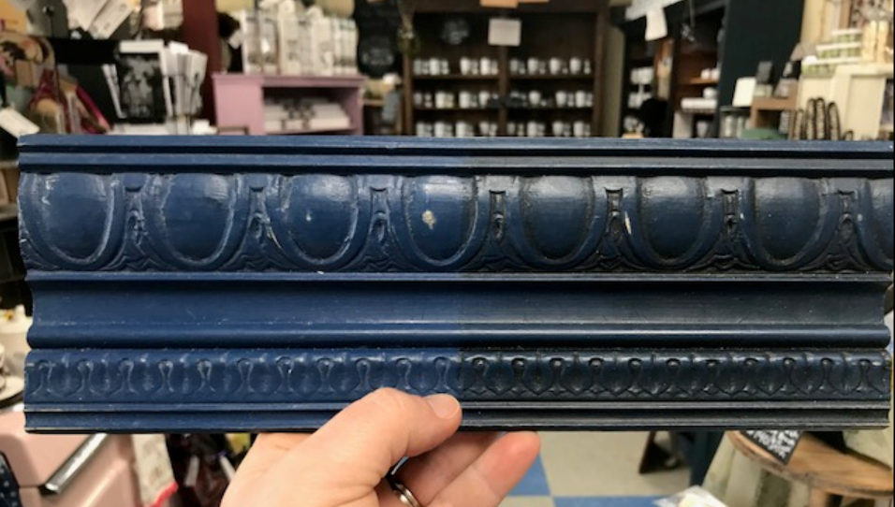
Napoleonic Blue
Clear Wax
Dark Wax
The Purple Painted Lady

